Slide 1
Raspberry PI Pico

Slide 2
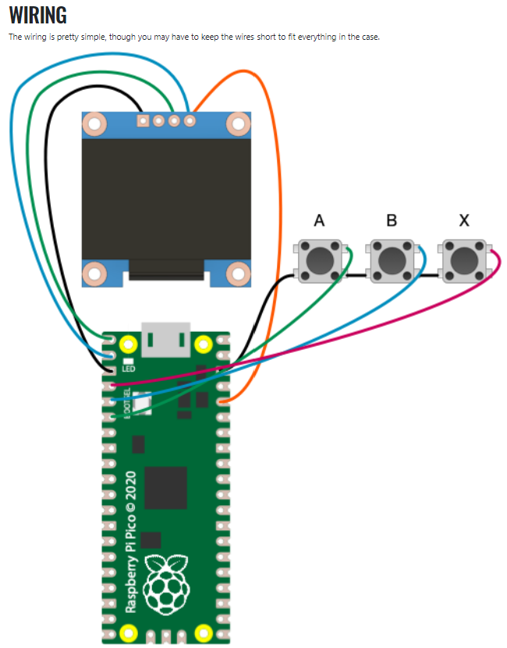
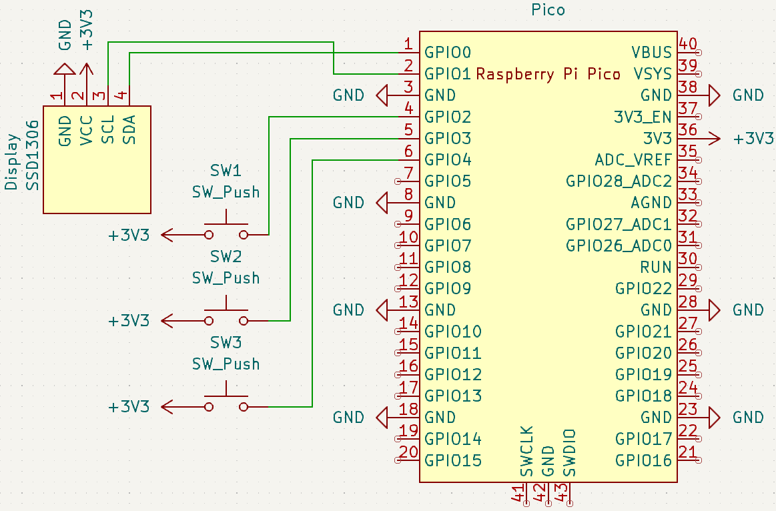
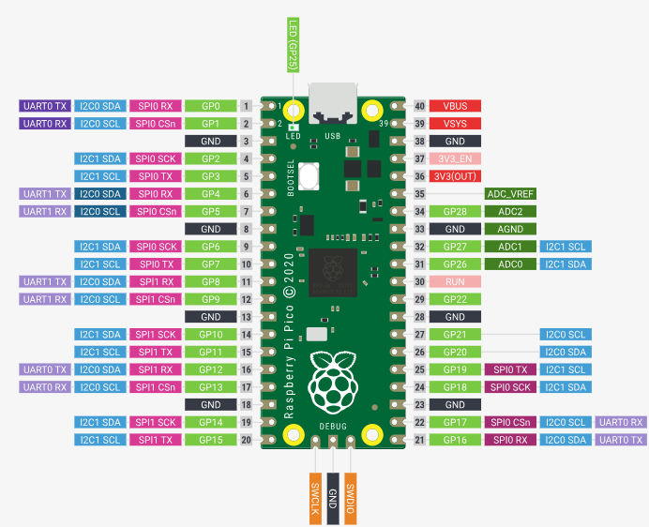
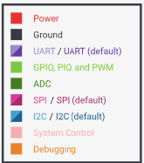
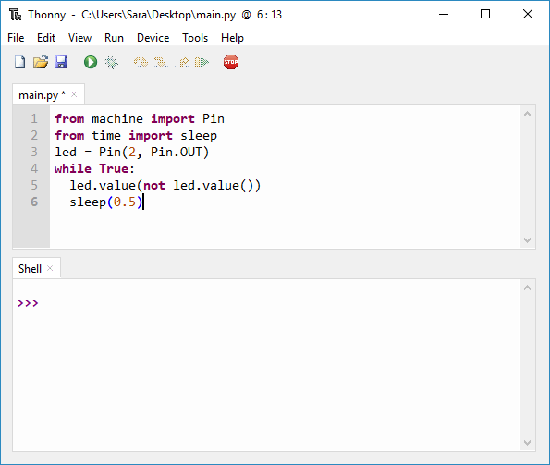

Filling in the gaps:
2
Fixing the schematic
Flashing the firmware (.uf2)
Lessons learned
1
2
There are problems with the suggested wiring
More explanation on how to flash the RPI with the correct firmware is needed
Information on how to configure Interpreter and COM port is needed in Thonny
A guide on how to view files and transfer the source code to the RPI is missing
The code is buggy and inefficient
Input Pins for buttons can be connected to HIGH (3.3V) or LOW (GND) (reference)
The source code has to match how the buttons are wired (PULL_UP vs. PULL_DOWN)
The Tamachibi code expects the pins to be connected to HIGH (3.3V)
TIP: Connect 3.3V and GND to the “rails” (red & blue) on one side of the breadboard and connect the buttons and peripherals to them
Hold the button on the RPI Pico
Connect the USB cable to the RPI and the Computer
The RPI appears as device in your file manager
Copy the .uf2 to the RPI
The RPI disconnects automatically (pling sound)
Disconnect the USB cable
Reconnect the USB cable
.uf2 file (latest)
Thonny

Slide 3
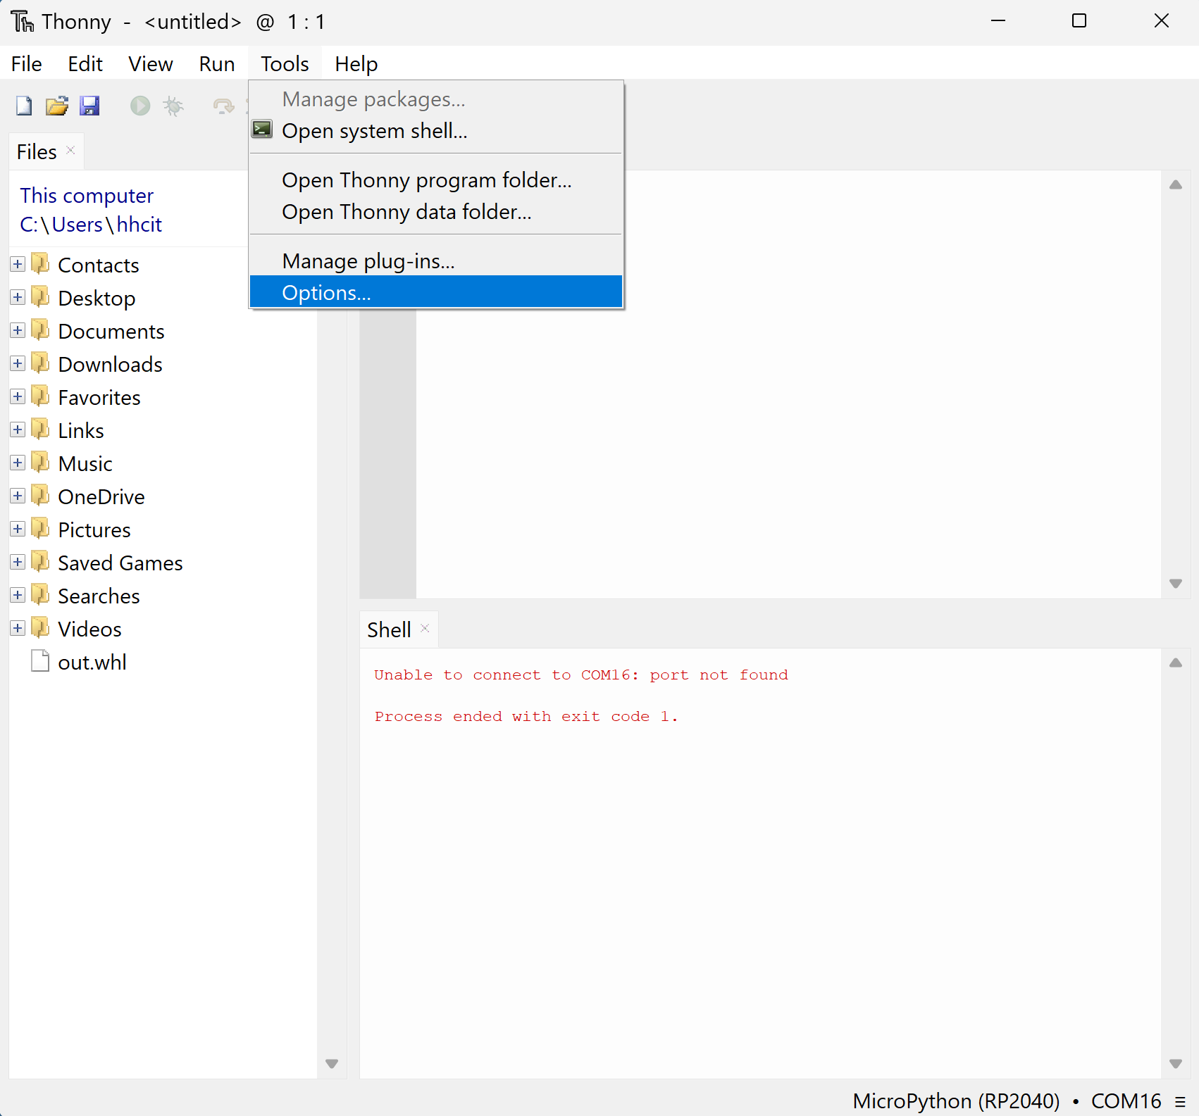
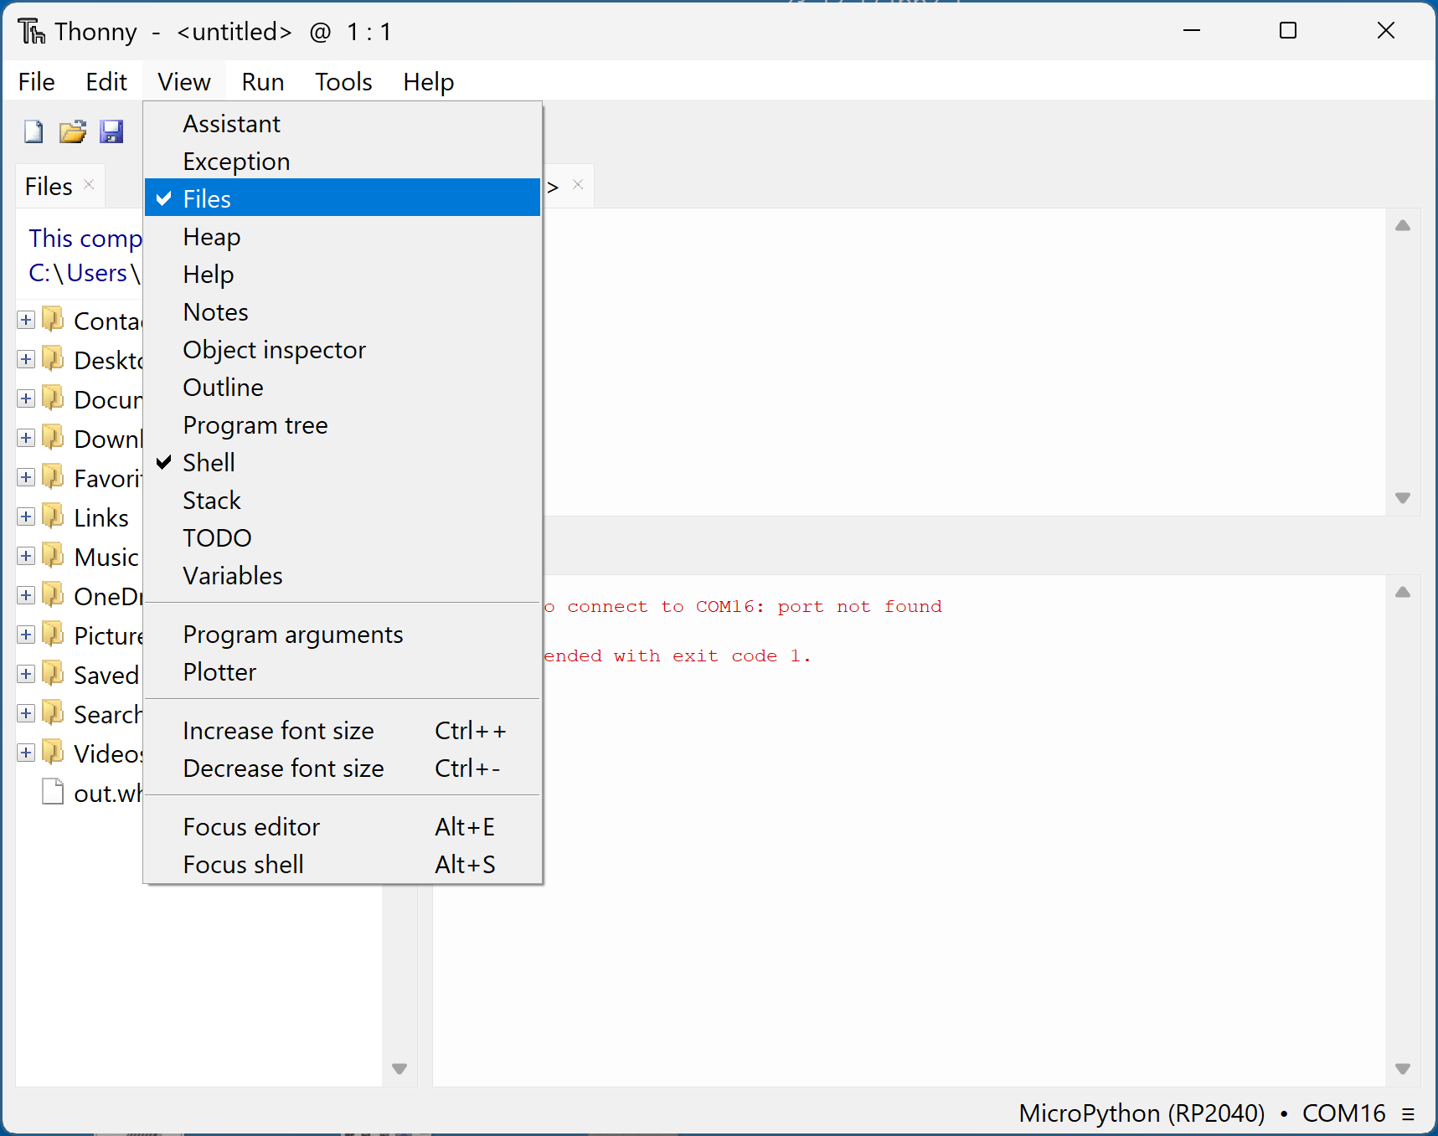
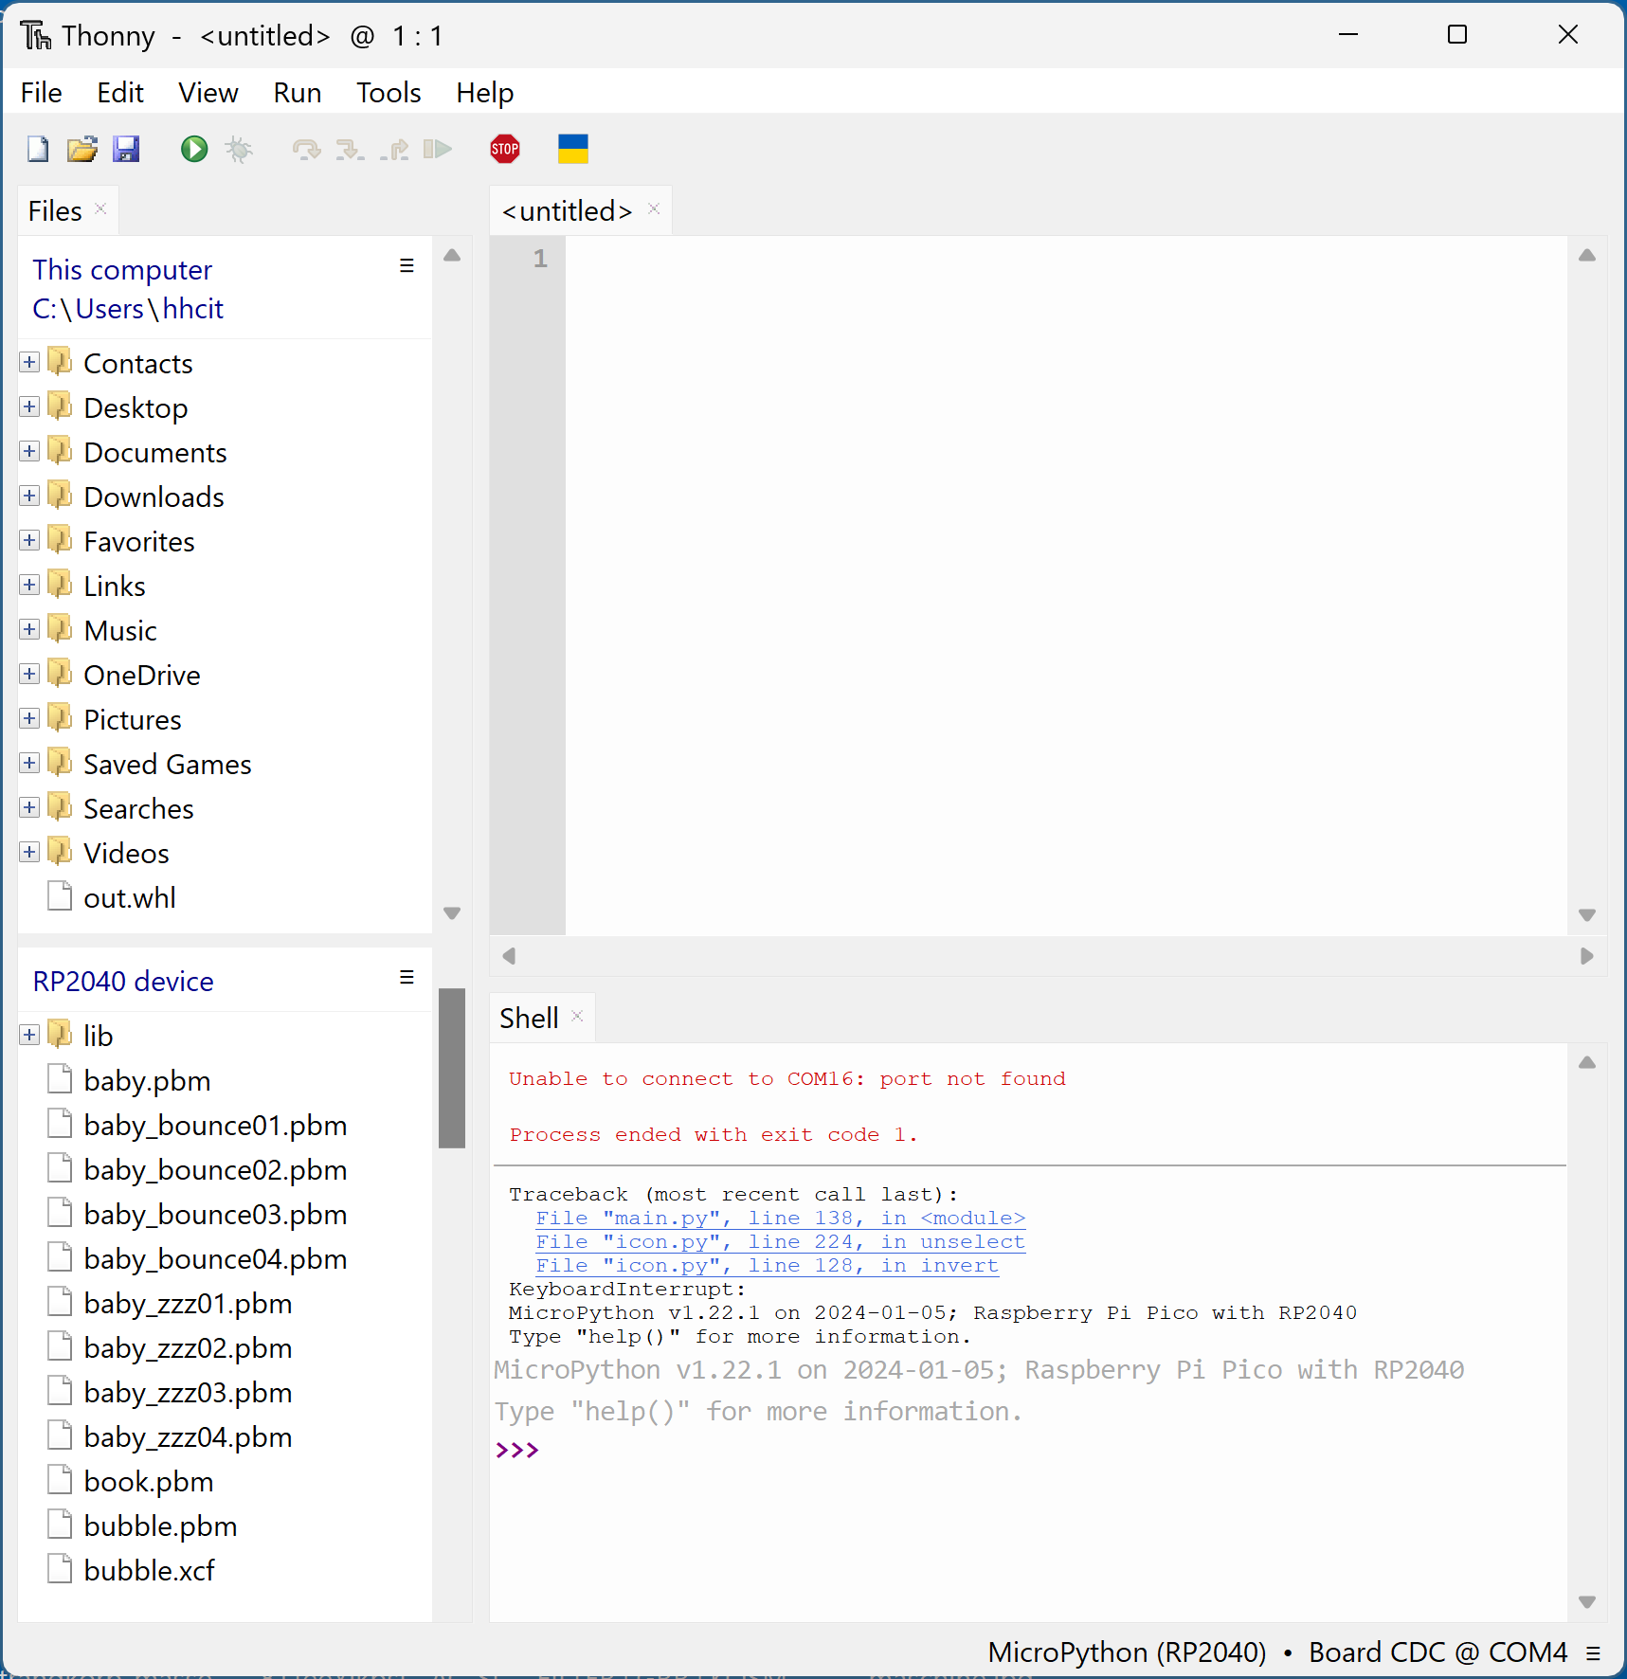
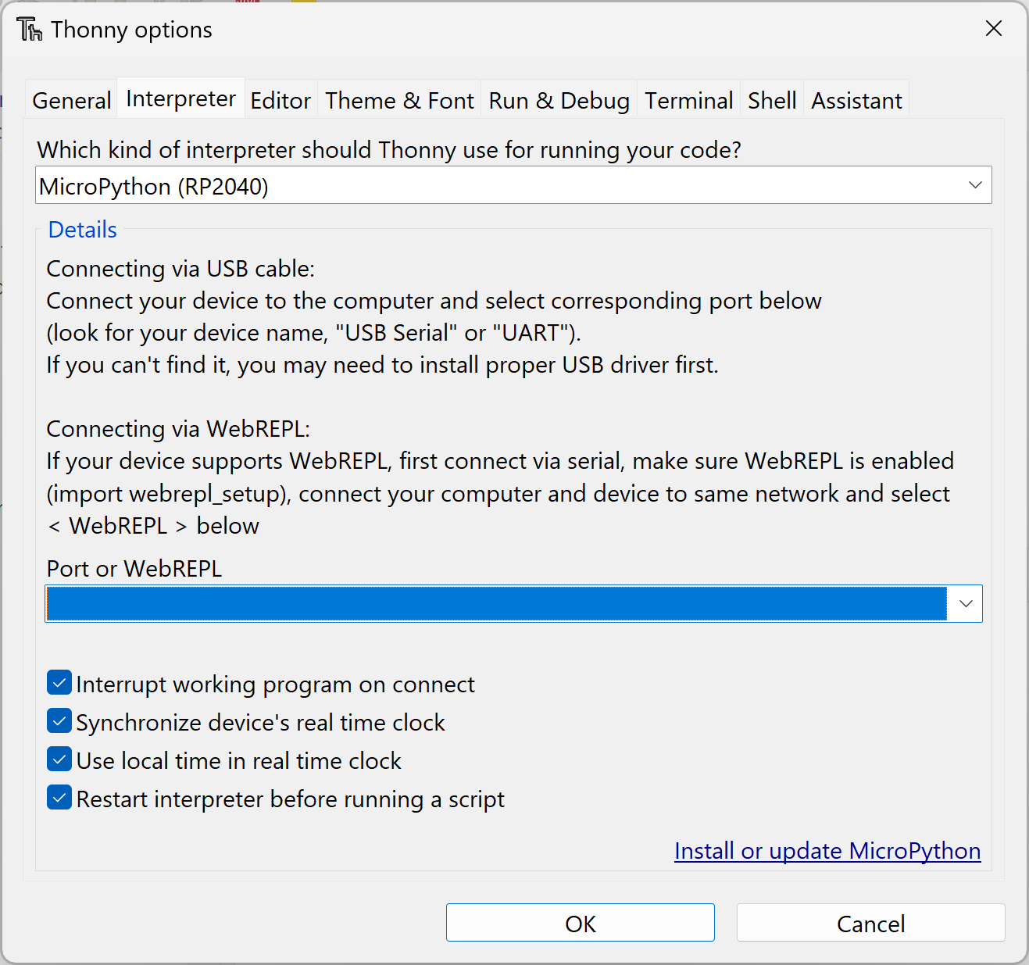
The source code:
Selecting Interpreter & COM port
Copying the files
Interpreter and COM
1
1
2
2
Board CDC @ COM
3
XX
Select Options from the Tools menu
Select the Interpreter tab
Select Micro Python (RP2040) as Interpreter
Select the COM port of your device
The number varies e.g. COM14
You have to repeat the port selection each time you connect a new RPI
Activate Files in the View menu
Copy the project to the RPI
All .PY and .pbm files
UI in the file selection is fiddly
Space on the RPI is limited you can not simply copy the whole repository

